Slide 1
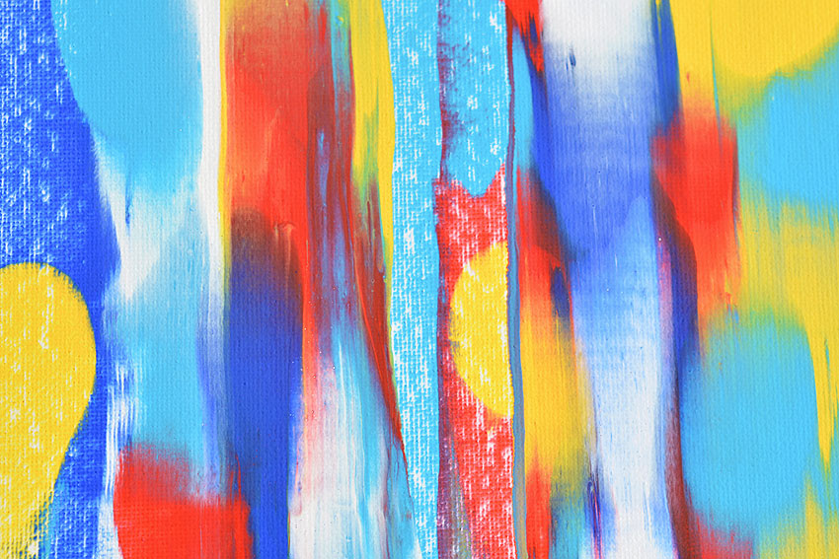
Squeegee Art

Slide 2
Supplies
Paper or Canvas
Squeegee or old plastic gift card
Acrylic paint
Old cookie tray or newspaper to keep table clean

Slide 3
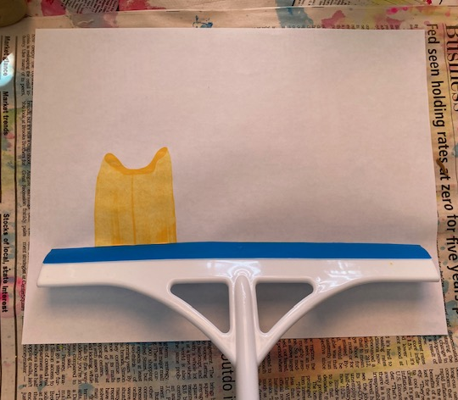
One Color / Simple Shape
Apply paint to paper or canvas
(tape paper down to keep
steady)
Pull squeegee straight down,
Wipe squeegee off on scratch paper or clean with a paper towel

Slide 4
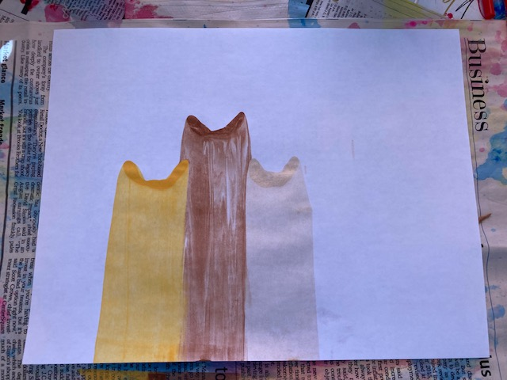
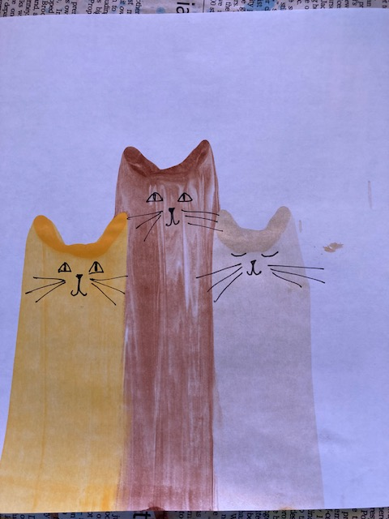
Repeat with other colors
Add details or other designs when dry

Slide 5
Simple, flat colors can be dynamic when overlapped. Use both transparent and opaque colors for different effects.

Slide 6
Multi-color Dot Swipe
Drop dots of paint in random patterns on the paper or canvas.
Fill most of the page, but leave some space in between dots.

Slide 7
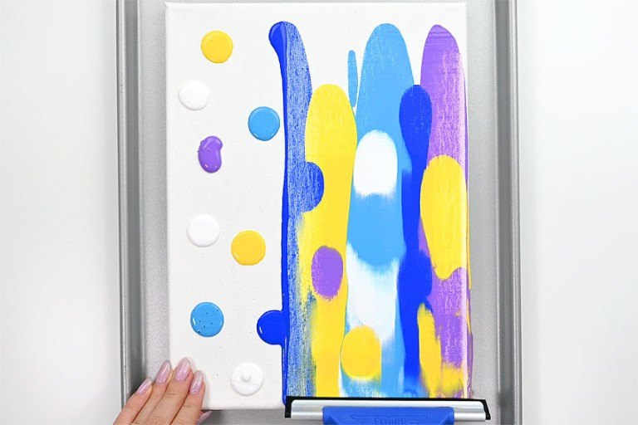
Pull down smoothly and evenly.
Wipe off the Squeegee or swipe it across
some scratch paper before pulling the
Squeegee across new paint.

Slide 8
Different colors create
different moods

Slide 9
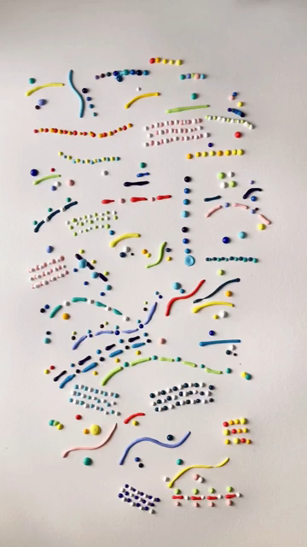
Multi-colors, lines , squiggles
Fill most of the page with dots, lines and squiggles.
Use the whole space, but leave some room in between

Slide 10
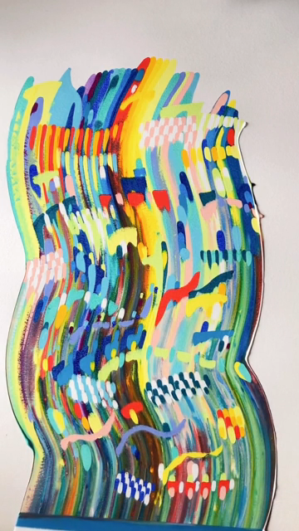

Slide 11
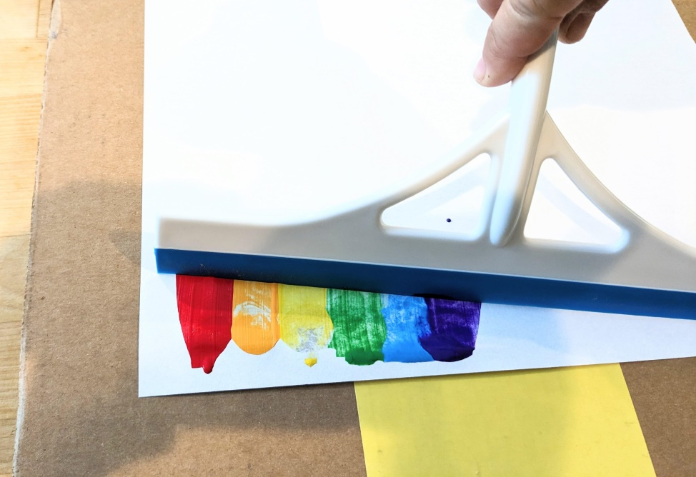
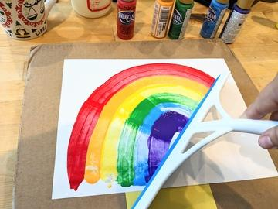
Squeegee Arcs and Circles
Drop colors in a line
Turn your wrist
as you pull.

Slide 12
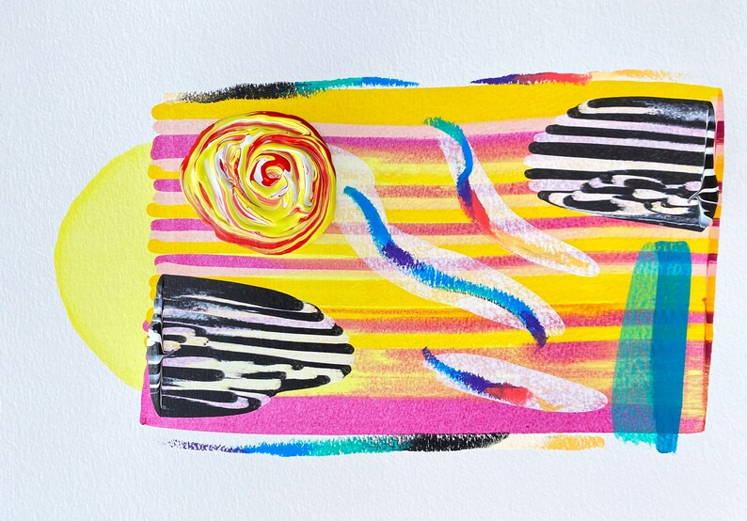
Combine techniques for a more
intricate design

Slide 13
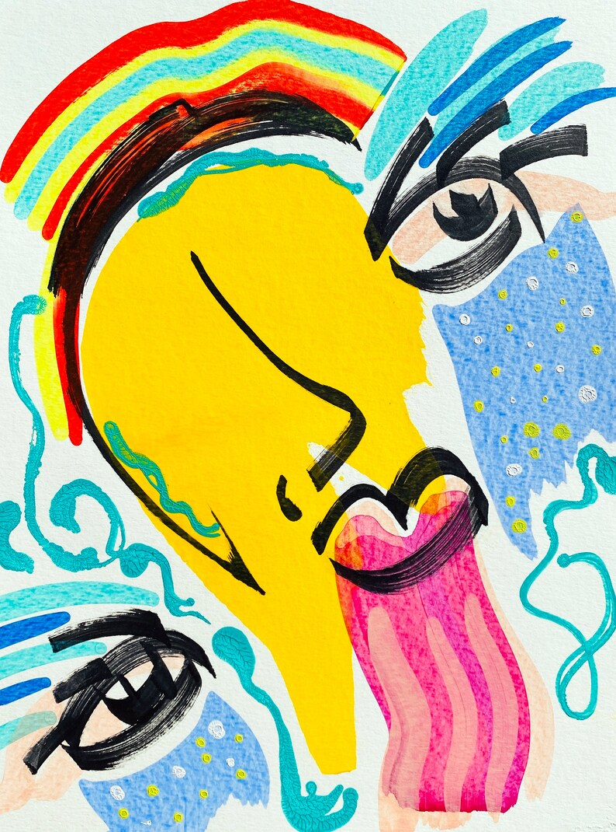

Slide 14
Compiled by
Julia M. Conley
juliaconley1021@gmail.com

